Slide 1
Prediction/Analysis of booking cancellations using Online travel booking company data
Prepared by:
Justice Arthur (N01613631)
Luting Chiu (N01604196)
Sachindra (N01640062)
ITE 5201 Humber College

Slide 2
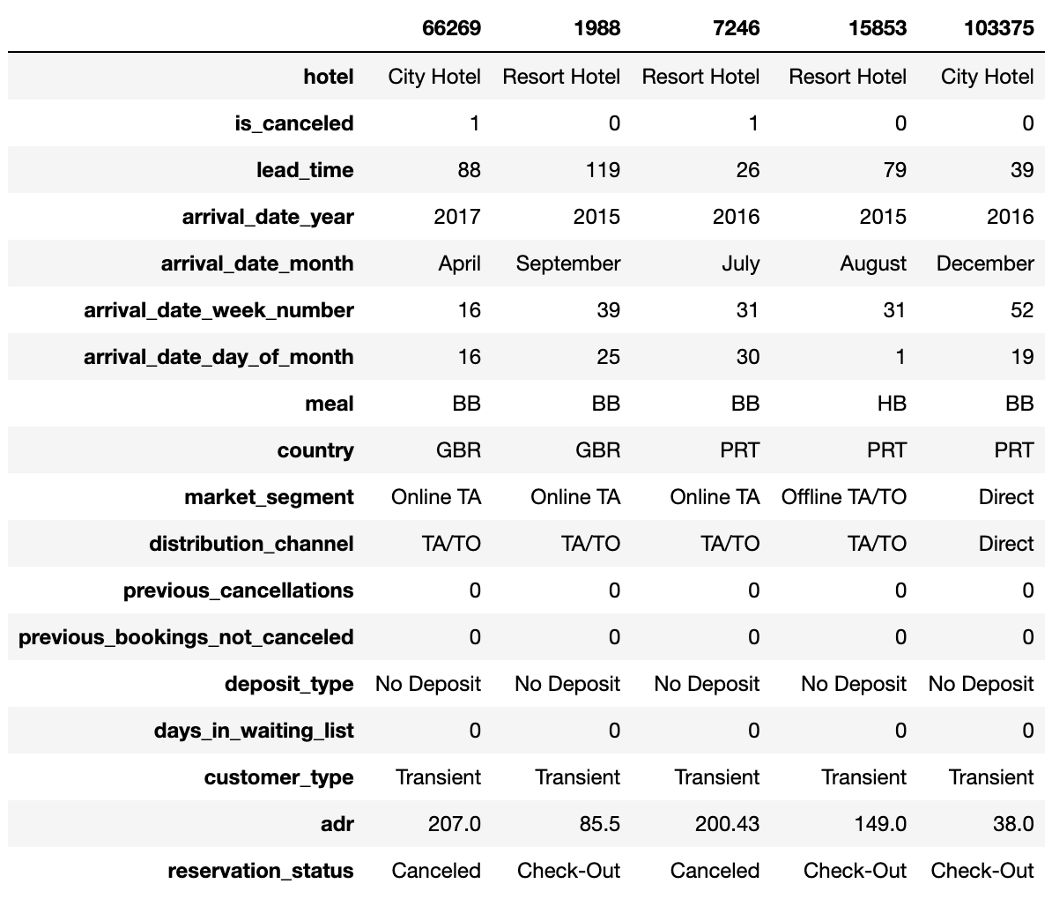
Problem Statement Prediction/Analysis of booking cancellations using Online travel booking company data
Dataset The determination of cancellation status (1 for canceled, 0 for not canceled) is shaped by a multitude of factors, encompassing customer behavior, temporal considerations, geographical location, and individual background. A set of dependent variables, encompassing hotel attributes, lead time, arrival date specifics, meal preferences, country, market segment, distribution channel, historical booking data, deposit type, days in the waiting list, customer type, and the average daily rate, were utilized to train the model for predicting cancellations in the dataset."

Slide 3
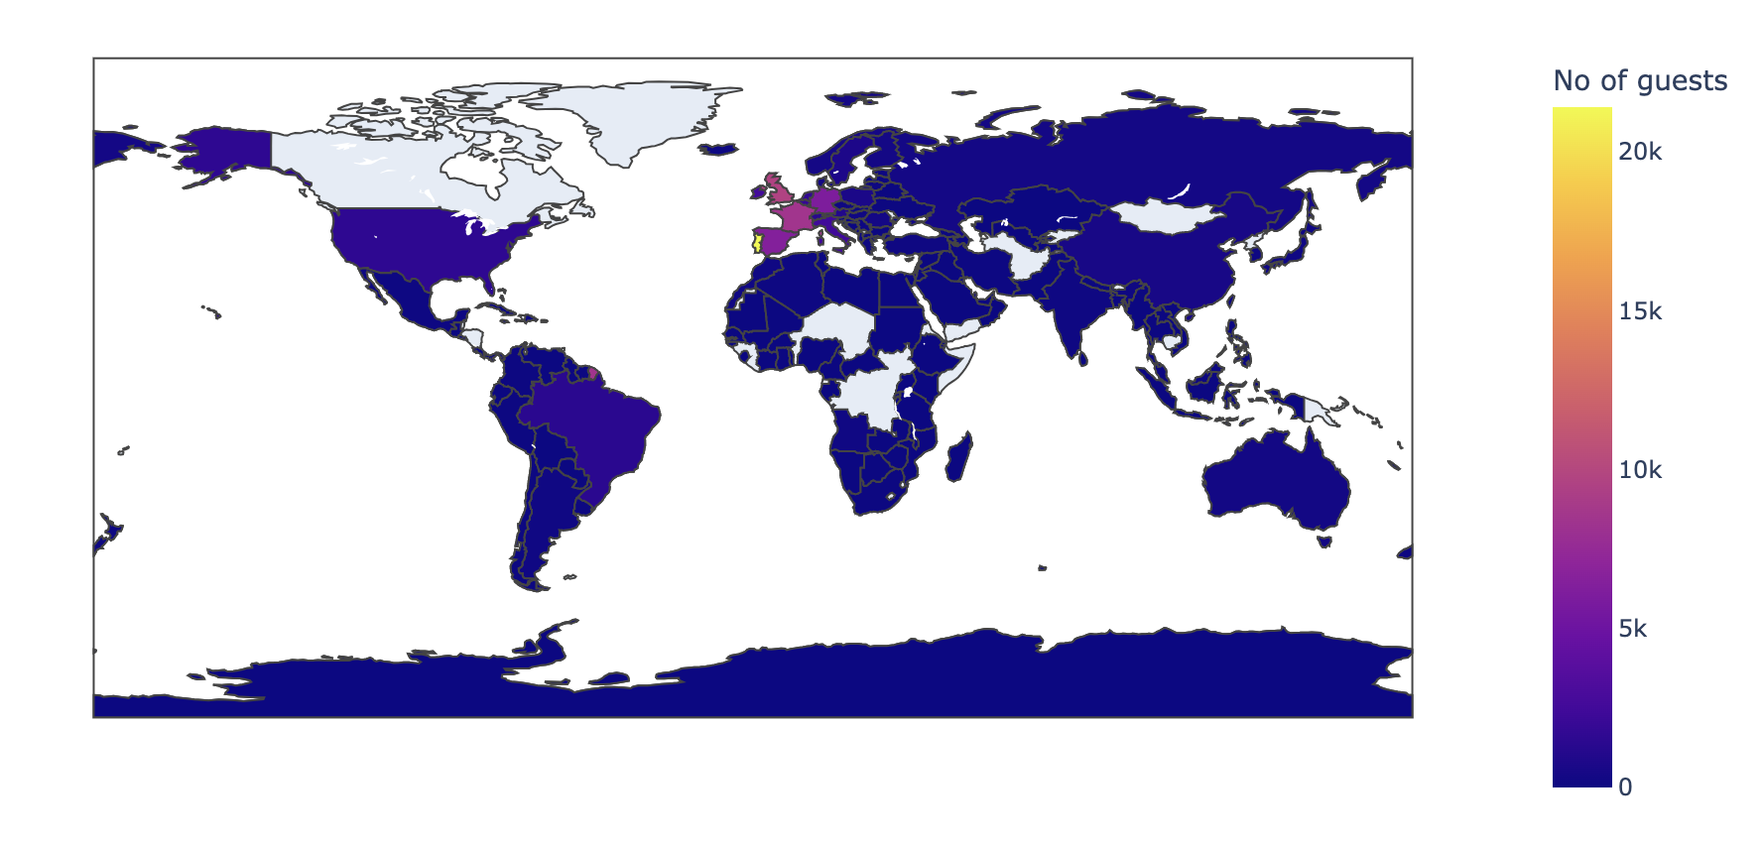
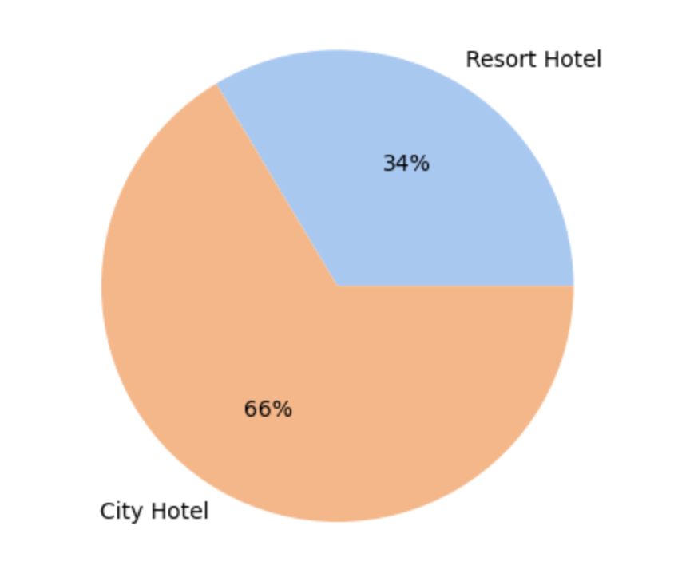
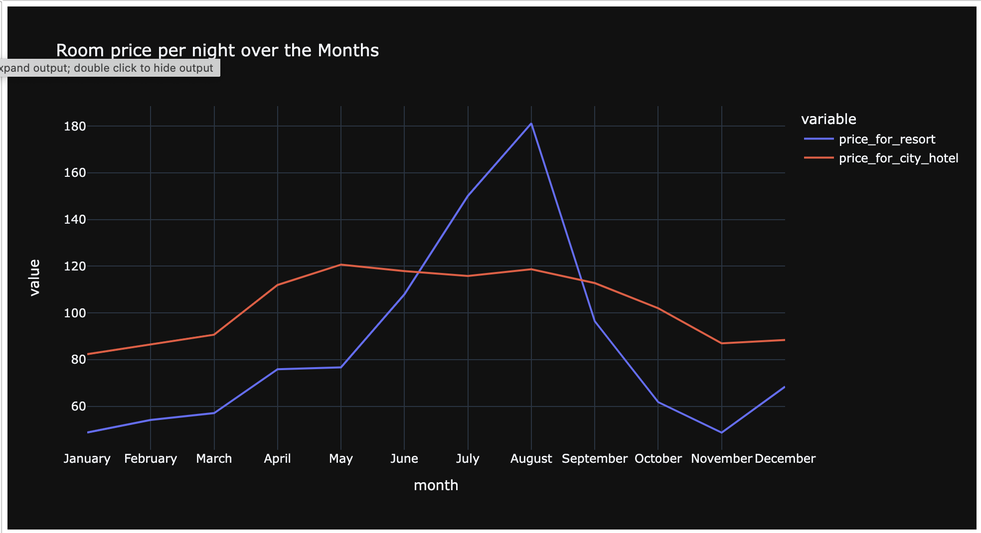
Statistical Plots

Slide 4
Proposed Analytical/ Predictive model Following data exploration and engineering, the model incorporates the variables: hotel, lead_time, arrival_date_year, arrival_date_month, arrival_date_week_number, arrival_date_day_of_month, meal, country, market_segment, distribution_channel, previous_cancellations, previous_booking_not_canceled, deposit_type, days_in_waiting_list, customer_type, and AverageDailyRate. The dataset is split into 75% training data and 25% testing data. With a categorical target variable (0 and 1), a logistic regression model (binomial) is applied for predictive analysis.

Slide 5
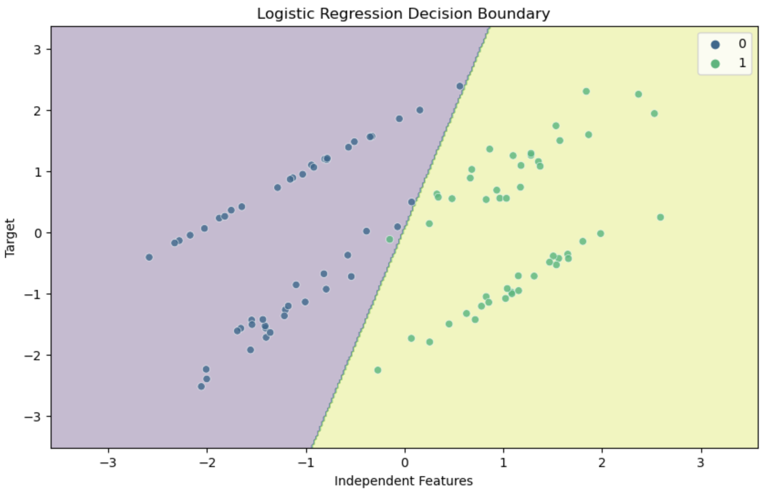
Proposed Predictive model… Logistic regression assumes a linear relationship between the independent features and the log-odds of the target. As a result, the decision boundary is a linear function of the features. The shape of the decision boundary reflects the linearity assumption of logistic regression.

Slide 6
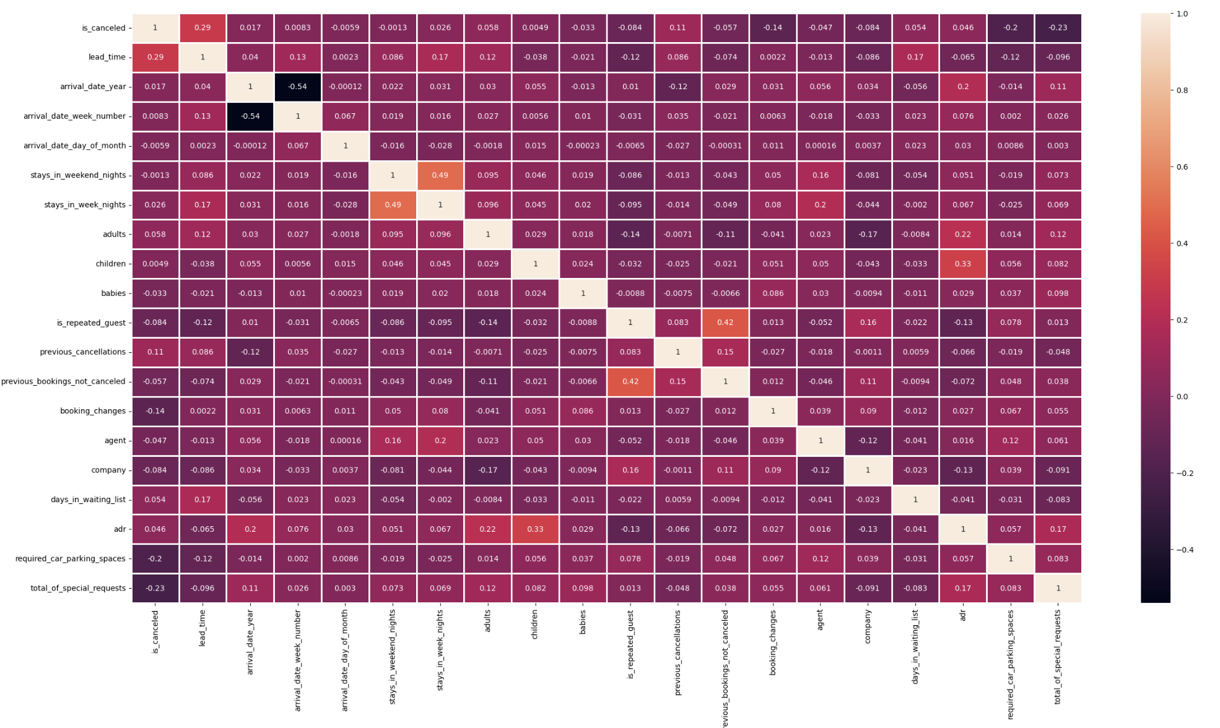
Analytical & Inference results Heatmap: Identifies the variables correlated with the cancellation status. Moreover, The linear progression here provides a visually intuitive way to understand the relative magnitudes of the values and their relationships within the dataset.

Slide 7
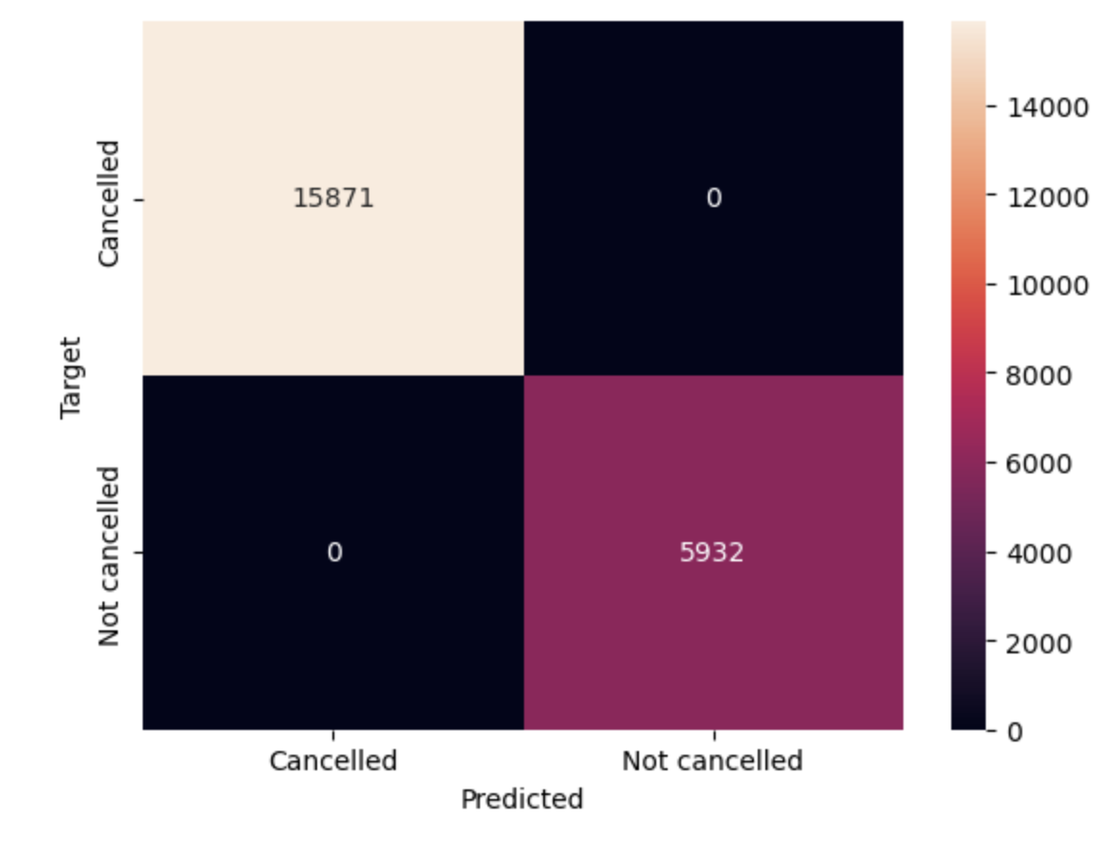
Analytical & Inference results Confusion matrix: Since the confusion matrix has FN (False Negatives) = 0 and FP (False Positives) = 0, it indicates that the model has made no errors in classifying the positive and negative instances. The prediction accuracy is indeed 100 percent.

